Slide 1
LiveScribe Pen

Slide 2
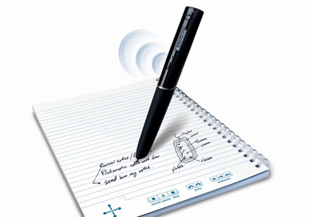
What is a LiveScribe Pen
It is a pen with a special notebook that allows the user to take notes and record what is being said.

Slide 3
Uses for Administrators
The Basics
http://video.scholastic.com/services/player/bcpid1543302482?bctid=762565180001
http://blogs.scholastic.com/bestintechtoday/2011/04/livescribe-echo-smartpen-lauren-j-ormsby.html

Slide 4
Uses for Math
How to Make Pencasts for Math
http://math247.pbworks.com/w/page/20517573/Mathcasts%20-%20Pencasts%20-%20LiveScribe%20SmartPen
Teachers can teach or re-teach any assignment any time
Example: http://calcvectors12.wikispaces.com/Pencasts
Flipped Classroom
http://karenblumberg.com/livescribe-pens-and-note-taking-apps-towards
Area Problems
http://www.livescribe.com/cgi-bin/WebObjects/LDApp.woa/wa/MLSOverviewPage?sid=7rC8kbJvNm9K

Slide 5
Uses for Science
Pencast for Light Energy
http://www.livescribe.com/cgi-bin/WebObjects/LDApp.woa/wa/MLSOverviewPage?sid=9PcVC4SSkBJK

Slide 6
Special Education
http://blog.smartpen.com.au/2010/02/15/livescribe-helping-students-with-disabilities/

Slide 7
Reading/Language Arts
Using Commas
http://www.livescribe.com/cgi-bin/WebObjects/LDApp.woa/wa/MLSOverviewPage?sid=L7dmTsLPbDG6

Slide 8
Foreign Language
Teaching Spanish Grammar
http://www.livescribek12.com/video-pencasting-spanish-class-grammar-lessons/

Slide 9
Economics
http://sites.google.com/site/inthelongrunecon/pencasts

Slide 10
Librarians
Using Audio Dots
(Livescribe sells these but they can easily be made with a punch.)
http://www.screencast.com/t/MTk2MzA3NDgt

Slide 11
Homebound Students
Have one of the students take notes with the pen and the notebook and then send the pen home with the homebound teacher. Connect the pen to the student’s computer and the pencast would be available to that student alone.
If the teacher wants to—they can publish their pencast but it is public.

Slide 12
With A Printed Page
http://screencast.com/t/WRmGAGe09
This will require Adobe Acrobat Professional.

Slide 13
Substitute Teacher
When the teacher is going to be absent, they can record examples using the livescribe pen and then the substitute teacher can touch the beginning and be taught by the regular teacher.

Slide 14
Critical Thinking
http://www.livescribek12.com/pencasting-to-support-critical-thinking/

